Slide 1
MORNING CASE CONF APR 7
BRIAN LOCKE, MD. CHIEF MEDICAL RESIDENT, INTERNAL MEDICINE

Slide 2
Introduction: Terms
Problem Representation:
One-sentence summary highlighting the defining features of the case to help generate a differential
Who is the patient?
What is the temporal pattern of illness?
What is the clinical syndrome?
Problem Representation:
Pertinent demographics/risk factors | Middle aged man Recent total knee replacement
Length/tempo | Acute
Key signs/symptoms | Pleuritic chest pain, shortness of breath, hemoptysis
@UtahIMCMRS
Notes:
From SGIM:
Teacher’s guide
Definition of PR:
Ask what the key ingredients of a problem representation are, can then click to reveal the 3 questions, and discuss examples of the kind of information that should be included
Who is the patient? What are the pertinent demographics and risk factors
What is the temporal pattern of the illness? What is the duration (hyperacute, acute, subacute, chronic) and tempo (stable, progressive, resolving, intermittent, waxing and waning)
What is the clinical syndrome? What are the key signs and symptoms

Slide 3
Introduction: Terms
CXR infiltrate
Schema:
Cognitive tool to systematically approach a clinical problem
Blood
Water
Pus
Alveolar hemorrhage
Pulmonary embolism
Pulmonary edema
ARDS
Aspiration
Pneumonia
@UtahIMCMRS

Slide 4
HPI THE foreground
CC: 23M with weight gain and swelling
-40lb weight gain in two months, progressive throughout the two months
-swelling in legs, abdomen, hands
-Abdominal pain: epigastric, worse w/ meals, associated w watery, loose stools
-No loose stools when not eating.
-Dyspnea on exertion
Problem Representation:
Pertinent demographics & risk factors | young
Length & tempo | Subacute, progressive
Key signs & symptoms => Syndrome | Swelling and GI symptoms
Differential Diagnosis
Renal -Nephrotic
Liver – cirrhosis
CHF
Schema
@UtahIMCMRS

Slide 5
History THE background
Medical: none
Surgical: none
Medications: none – prn benadryl
Social: No smoking, no IVDU, heavy use of etoh once every few months. Not sexually active.
Family: Mother died when he was young (patient not sure of what), father, siblings healthy
Problem Representation:
Pertinent demographics & risk factors | Young, generally healthy but w/ at risk drinking
Length & tempo | Subacute, progressive
Key signs & symptoms => Syndrome | Swelling and GI symptoms
Differential Diagnosis
Renal -Nephrotic
Liver – cirrhosis
CHF
Schema
@UtahIMCMRS

Slide 6
objective vitals and exam
VS: 37.4, P 124, RR 18, BP 115/87, pOx 95% on RA-1L. Bmi 32
GEN: nontoxic, conversant, fatigued
HEENT: periorbital swelling
CV: rrr, no murmurs
Pulm: vesicular breath sounds, normal work of breathing, good air movement throughout
Abd: mildly tender throughout but no rebound or guarding, distended
Ext: 2+ LE edema, puffy hands
Neuro: face symmetric, moving extremities x4, no tremor
Psych: linear thought, appropriate affect
Skin: no rashes
Problem Representation:
Pertinent demographics & risk factors | Young, generally healthy but w/ at risk drinking (fam hx early death)
Length & tempo | Subacute, progressive
Key signs & symptoms => Syndrome | Anasarca and GI symptoms
Differential Diagnosis
Renal –Nephrotic, nephritic, alports
Liver – cirrhosis
CHF
Protein losing – enteropathy
Myxedema
Malnutrition
Malabsorption
Poor intake
Schema
@UtahIMCMRS

Slide 7
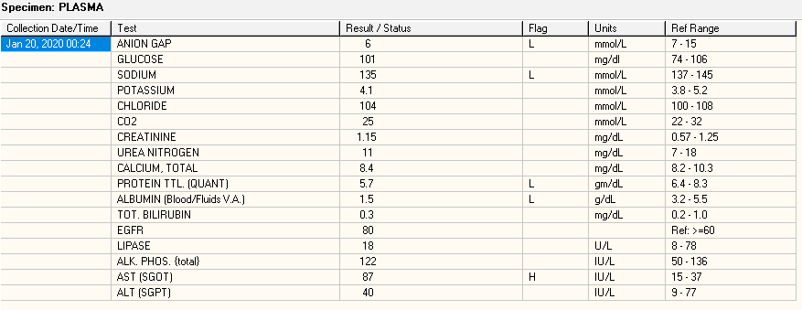
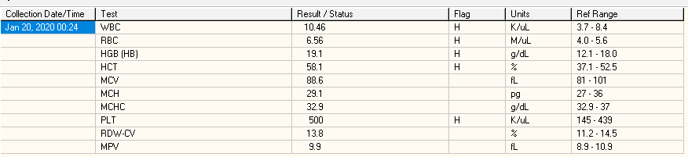

objective basic labs
Problem Representation:
Pertinent demographics & risk factors | Young, generally healthy but w/ at risk drinking (fam hx early death)
Length & tempo | Subacute, progressive
Key signs & symptoms => Syndrome | Anasarca and GI symptoms, intravascular depletion
Differential Diagnosis
Renal –Nephrotic, nephritic, alports
Liver – cirrhosis
CHF
Protein losing – enteropathy
Myxedema
Malnutrition
Malabsorption
Poor intake
Schema
@UtahIMCMRS

Slide 8

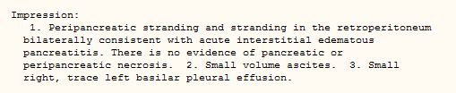

objective investigations
Schema
@UtahIMCMRS

Slide 9
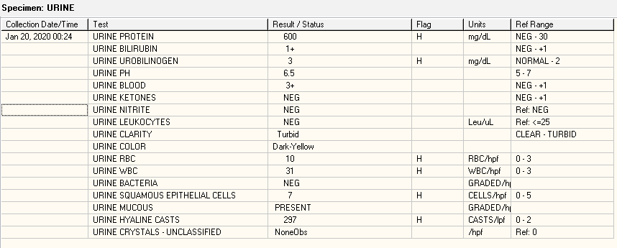
objective investigations
Problem Representation:
Pertinent demographics & risk factors | Young, generally healthy but w/ at risk drinking (fam hx early death)
Length & tempo | Subacute, progressive
Key signs & symptoms => Syndrome | Nephrotic range proteinuria
Differential Diagnosis
Nephrotic range proteinuria
-edema, proteinuria, hypoalbuminia,
Hypercoagulable
=>liipds
3+ blood ->
-alports
-nephritic
-nephrotic
Schema
@UtahIMCMRS

Slide 10
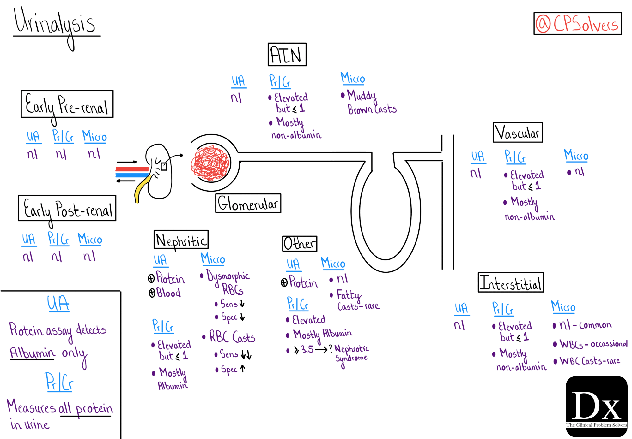
objective investigations
@UtahIMCMRS

Slide 11
objective investigations
Problem Representation:
Pertinent demographics & risk factors | Young, generally healthy but w/ at risk drinking (fam hx early death)
Length & tempo | Subacute, progressive
Key signs & symptoms => Syndrome | Nephrotic range proteinuria
A1c 5.1
TSH 7.76 (H) (Free T4 and T3 low)
C3 144
C4 40
HbSab reactive, HbSag nonreactive
HIV/Syphilis
ANCA negative
HCV negative
Cryo negative
Differential Diagnosis
Nephrotic range proteinuria
-edema, proteinuria, hypoalbuminia,
Hypercoagulable
=>liipds
3+ blood ->
-alports
-nephritic
-nephrotic
Schema
@UtahIMCMRS

Slide 12
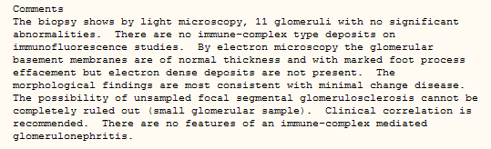
objective to the diagnosis
Renal biopsy
Schema
@UtahIMCMRS

Slide 13
Summary: key points
DIAGNOSIS: MINIMAL CHANGE DISEASE
Illness Script: cause of nephrotic syndrome in young adults. Presents with subacute anasarca, proteinuria, and hematuria (when seen in adults).
Think about problem representations!
Who is the patient?
What is the temporal pattern of illness?
What is the clinical syndrome?
UA: Active sediment vs Bland Sediment
Could this be a problem in the glomerulus?
@UtahIMCMRS

Slide 14
bonus management
Discharged on:
Prednisone
Lisinopril
Apixaban
Furosemide
Bactrim
25mcg LT4, atorva.
Why?
@UtahIMCMRS

Slide 15


